Slide 1
AWS EC2

Slide 2
What is EC2?
EC2 is one of the most popular of AWS’ offering
• EC2 = Elastic Compute Cloud = Infrastructure as a Service
• It mainly consists in the capability of :
• Renting virtual machines (EC2)
• Storing data on virtual drives (EBS)
• Distributing load across machines (ELB)
• Scaling the services using an auto-scaling group (ASG)

Slide 3
EC2 Sizing and Configuration
Operating System (OS): Linux, Windows or Mac OS
• How much compute power & cores (CPU)
• How much random-access memory (RAM)
• How much storage space:
• Network-attached (EBS & EFS)
• hardware (EC2 Instance Store)
• Network card: speed of the card, Public IP address
• Firewall rules: security group
• Bootstrap script (configure at first launch): EC2 User Data

Slide 4
EC2 User Data
It is possible to bootstrap our instances using an EC2 User data script.
• bootstrapping means launching commands when a machine starts
• That script is only run once at the instance first start
• EC2 user data is used to automate boot tasks such as:
• Installing updates
• Installing software
• Downloading common files from the internet
• Anything you can think of
• The EC2 User Data Script runs with the root user

Slide 5
EC2 Instance Types
AWS has Regions all around the world
You can use different types of EC2 instances that are optimised for
different use cases (https://aws.amazon.com/ec2/instance-types/)
• AWS has the following naming convention:
m5.2xlarge
• m: instance class
• 5: generation (AWS improves them over time)
• 2xlarge: size within the instance class

Slide 6
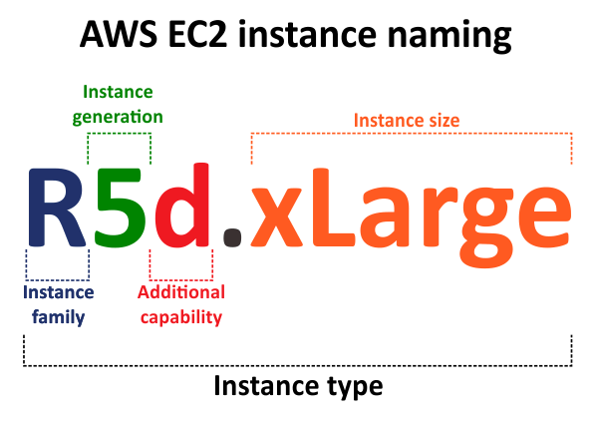

Slide 7
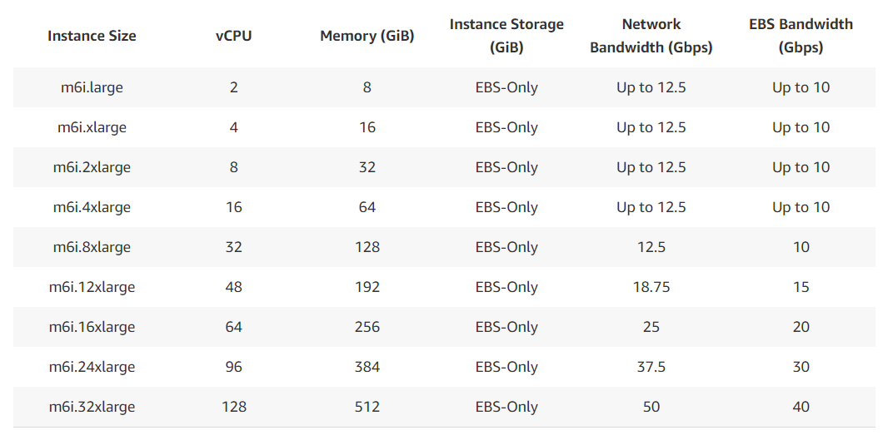

Slide 8
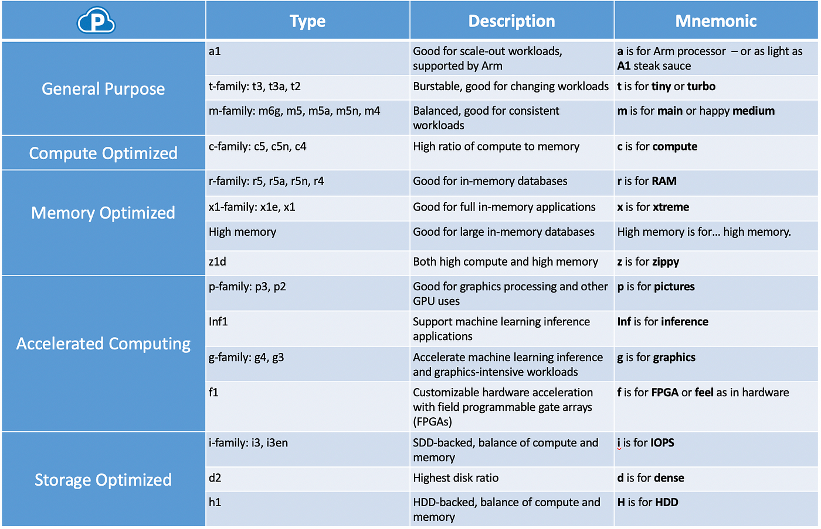

Slide 9
General Purpose
Great for a diversity of workloads such as web servers or code repositories
Balance between:
• Compute
• Memory
• Networking

Slide 10
Compute Optimized
Great for compute-intensive tasks that require high performance
processors:
• Batch processing workloads
• Media transcoding
• High performance web servers
• High performance computing (HPC)
• Scientific modeling & machine learning
• Dedicated gaming servers

Slide 11
Memory Optimized
Fast performance for workloads that process large data sets in memory
• Use cases:
• High performance, relational/non-relational databases
• Distributed web scale cache stores
• In-memory databases optimized for BI (business intelligence)
• Applications performing real-time processing of big unstructured data

Slide 12
Storage Optimized
Great for storage-intensive tasks that require high, sequential read and write access to large data sets on local storage
Use cases:
• High frequency online transaction processing (OLTP) systems
• Relational & NoSQL databases
• Cache for in-memory databases (for example, Redis)
• Data warehousing applications
• Distributed file systems

Slide 13
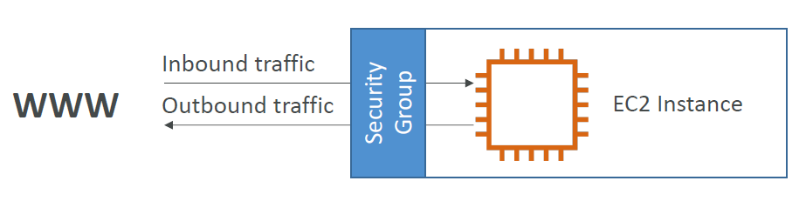
Security Group
Security Groups are the fundamental of network security in AWS
• They control how traffic is allowed into or out of our EC2 Instances.
• Security groups only contain allow rules
• Security groups rules can reference by IP or by security group

Slide 14
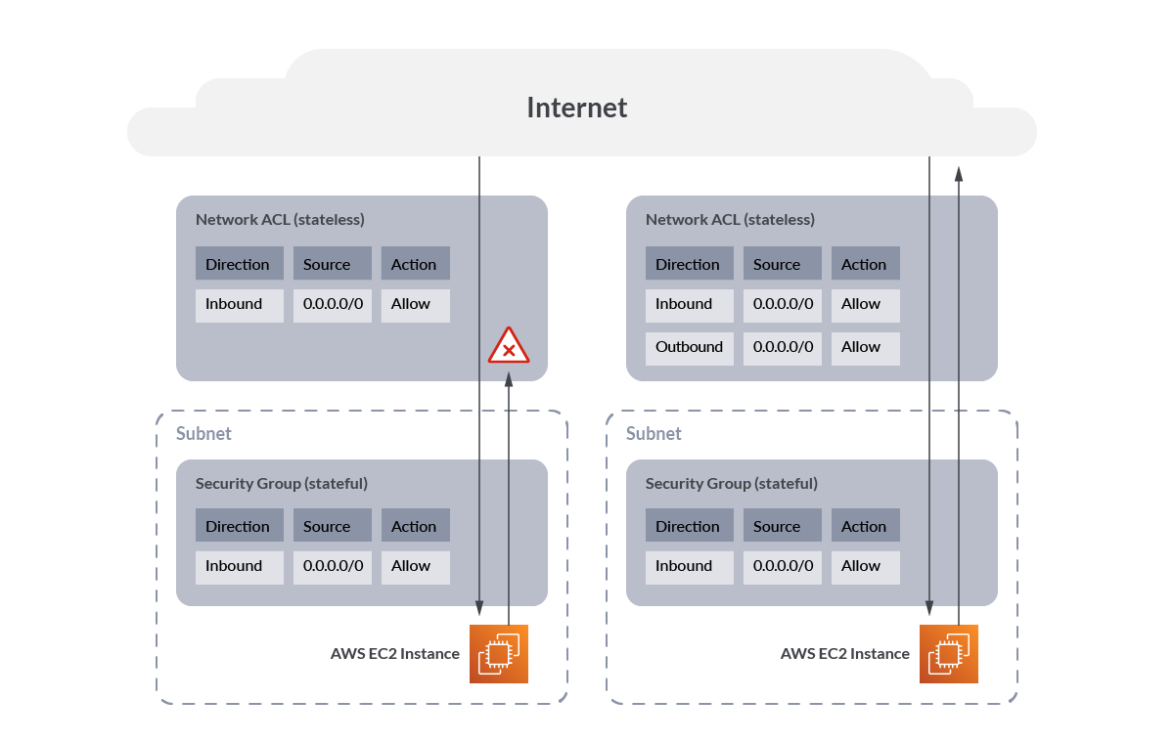

Slide 15
Can be attached to multiple instances
• Locked down to a region / VPC combination
• Does live “outside” the EC2 – if traffic is blocked the EC2 instance won’t see it
• It’s good to maintain one separate security group for SSH access
• If your application is not accessible (time out), then it’s a security group issue
• If your application gives a “connection refused“ error, then it’s an application
error or it’s not launched
• All inbound traffic is blocked by default
• All outbound traffic is authorised by default

Slide 16
Ports
22 = SSH (Secure Shell) - log into a Linux instance
21 = FTP (File Transfer Protocol) – upload files into a file share
22 = SFTP (Secure File Transfer Protocol) – upload files using SSH
80 = HTTP – access unsecured websites
443 = HTTPS – access secured websites
3389 = RDP (Remote Desktop Protocol) – log into a Windows instance

Slide 17
EC2 Instances purchasing options
On-Demand Instances – short workload, predictable pricing, pay by seconds or hours for spiky workloads
Reserved (1 & 3 years) Get significant discount on hourly charge and capacity commitment. For commited utilization and capacity reservation.
• Reserved Instances – long workloads
• Convertible Reserved Instances – long workloads with flexible instances
Savings Plans (1 & 3 years) –commitment to an amount of usage, long workload
Spot Instances – short workloads, cheap, can lose instances (less reliable). Bid for unused capacity, charged big price that fluctuates over time
Dedicated Hosts – book an entire physical server, control instance placement
Dedicated Instances – no other customers will share your hardware
Capacity Reservations – reserve capacity in a specific AZ for any duration

Slide 18
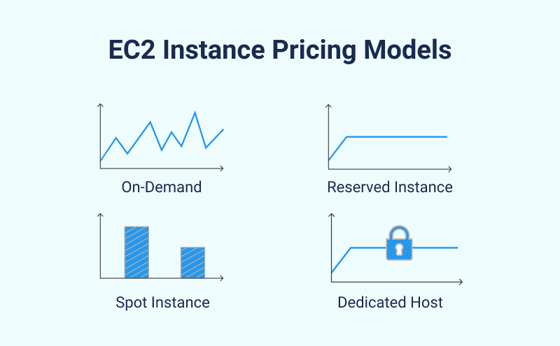

Slide 19
EC2 Spot Instances
Can get a discount of up to 90% compared to On-demand
• Instances that you can “lose” at any point of time if your max price is less than the
current spot price
• The MOST cost-efficient instances in AWS
• Useful for workloads that are resilient to failure
• Batch jobs
• Data analysis
• Image processing
• Any distributed workloads
• Workloads with a flexible start and end time
• Not suitable for critical jobs or databases

Slide 20
• Define max spot price and get the instance while current spot price < max
• The hourly spot price varies based on offer and capacity
• If the current spot price > your max price you can choose to stop or terminate your
instance with a 2 minutes grace period.
• Other strategy: Spot Block
• “block” spot instance during a specified time frame (1 to 6 hours) without interruptions
• In rare situations, the instance may be reclaimed
• Used for batch jobs, data analysis, or workloads that are resilient to failures.
• Not great for critical jobs or databases
You can only cancel Spot Instance requests that are open, active, or disabled.
Cancelling a Spot Request does not terminate instances
You must first cancel a Spot Request, and then terminate the associated Spot Instances

Slide 22
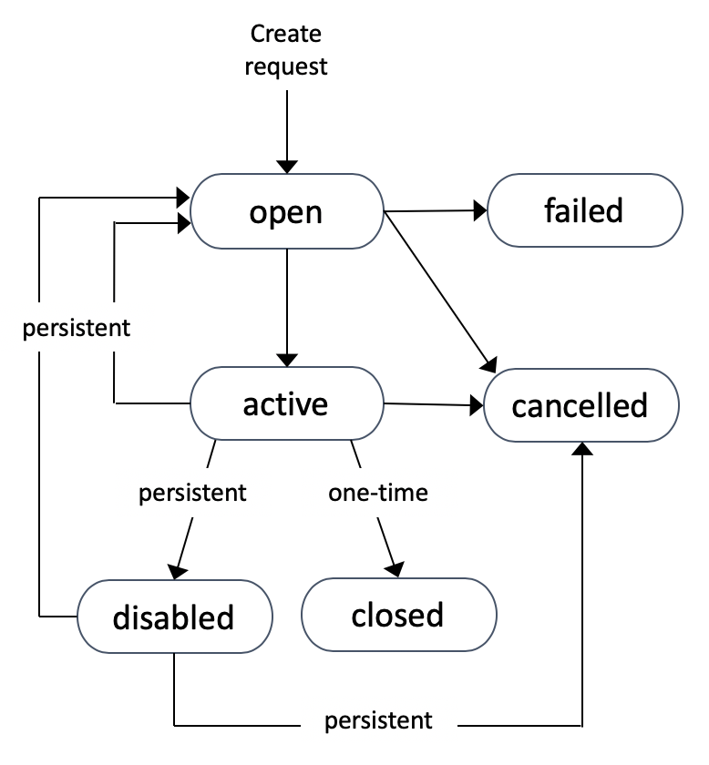

Slide 23
Spot fleet
Spot Fleets = set of Spot Instances + (optional) On-Demand Instances
• The Spot Fleet will try to meet the target capacity with price constraints
• Define possible launch pools: instance type (m5.large), OS, Availability Zone
• Can have multiple launch pools, so that the fleet can choose
• Spot Fleet stops launching instances when reaching capacity or max cost
Strategies to allocate Spot Instances:
• lowestPrice: from the pool with the lowest price (cost optimization, short workload)
• diversified: distributed across all pools (great for availability, long workloads)
• capacityOptimized: pool with the optimal capacity for the number of instances
• priceCapacityOptimized (recommended): pools with highest capacity available, then select
the pool with the lowest price (best choice for most workloads)
• Spot Fleets allow us to automatically request Spot Instances with the lowest price

Slide 24
EC2 Dedicated Hosts
A physical server with EC2 instance capacity fully dedicated to your use
• Allows you address compliance requirements and use your existing serverbound
software licenses (per-socket, per-core, pe—VM software licenses)
• Purchasing Options:
• On-demand – pay per second for active Dedicated Host
• Reserved - 1 or 3 years (No Upfront, Partial Upfront, All Upfront)
• The most expensive option
• Useful for software that have complicated licensing model (BYOL – Bring Your
Own License)
• Or for companies that have strong regulatory or compliance needs

Slide 25
EC2 Dedicated Instances
Instances run on hardware that’s dedicated to you
• May share hardware with other instances in same account
• No control over instance placement
(can move hardware after Stop / Start)

